Slide 1
AZ-220T01 Module 04: Message Processing and Analytics

Slide 2
Lesson 01: Learning objectives

Slide 3
Module 4 – Learning objectives
Configure message and event routing
Route data to the built-in and custom endpoints
Implement message enrichment
Implement Azure Stream Analytics Inputs, Queries, and Outputs
Store message data in a warm storage for archival purposes and additional analysis
Use an Azure Function within a message processing and analytics solution

Slide 4
Lesson 02: Messages and Message Processing

Slide 5
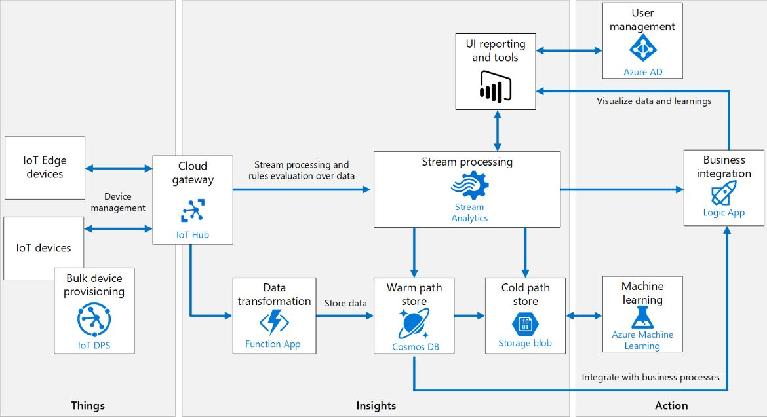
What is Message Processing?
Notes:
Basic path:
Devices generate messages in the form of telemetry data
IoT Hub routes messages to desired endpoints
Azure Stream Analytics processes messages and stores the data
In addition
IoT Hub defines a common message format
Messages can be enriched and transformed during processing
Business integration (Module 5) includes additional processing

Slide 6
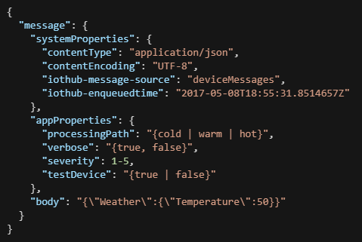
IoT Hub Common Message Format
Purpose
Characteristics
Retained up to 7 days
256 KB size limit
Partitioned based on deviceId
Supports message enrichment
Components
System properties
Application properties - do not require deserialization
Message body - opaque
Notes:
Common Message Format is used for both device-to-cloud routing and cloud-to-device messages to support seamless interoperability across protocols
Device-to-cloud messaging characteristics:
Retained up to 7 days (see below)
256 KB size limit (“size” determined as described below) for messages and for batches
Partitioned based on deviceId
Supports message enrichment (to be described in detail later)
Message components:
System properties
Application properties
Message body
Message size
Anti-spoofing
IoT Hub allows data retention in the built-in Event Hubs for a maximum of 7 days. You can set the retention time during creation of your IoT Hub. Data retention time in IoT Hub depends on your IoT hub tier and unit type. In terms of size, the built-in Event Hubs can retain messages of the maximum message size up to at least 24 hours of quota. For example, for 1 S1 unit IoT Hub provides enough storage to retain at least 400K messages of 4k size each. If your devices are sending smaller messages, they may be retained for longer (up to 7 days) depending on how much storage is consumed. We guarantee retaining the data for the specified retention time as a minimum.
(https://docs.microsoft.com/en-us/azure/iot-hub/iot-hub-devguide-messages-read-builtin)
Message size
IoT Hub measures message size in a protocol-agnostic way, considering only the actual payload. The size in bytes is calculated as the sum of the following values:
The body size in bytes.
The size in bytes of all the values of the message system properties.
The size in bytes of all user property names and values.
Property names and values are limited to ASCII characters, so the length of the strings equals the size in bytes.

Slide 7
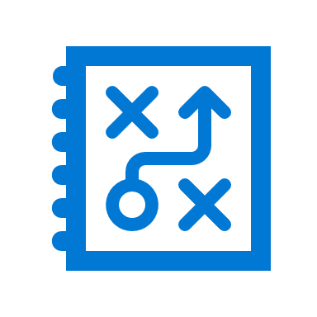
Introduction to Message Routing
Endpoints
Built-in
Custom
Queries
Source
Condition
Endpoint
Notes:
Message routing is the flow of messages between endpoints based on conditions applied to messages from a source, then sent to endpoints.
The endpoints were listed earlier in the course so that part is a review (Module 2, Lesson 2) for now – we’re going to deep dive on it here.

Slide 8
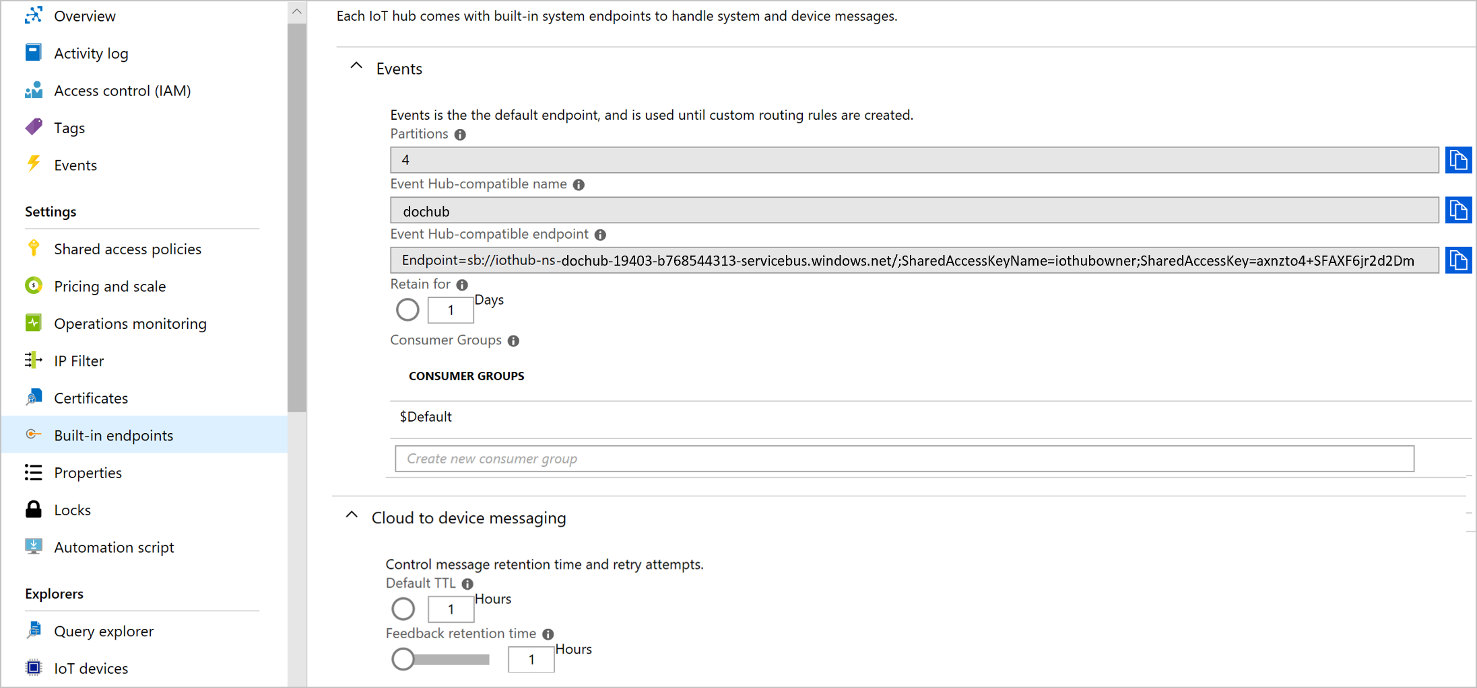
IoT Hub Built-in Endpoint
Notes:
Configurable properties
Partition count
Retention time
Accessing the Built-in Endpoint
aware of IoT Hub
unaware of IoT Hub
Note: “partition” in this context is a complicated topic that is not necessarily well explained in the documentation. Essentially, for scalability, Event Hubs (which are the base for IoT Hubs) support a model where messages are routed to different partitions, which each partition can have one active consumer group at a time. This allows for scaling of message processing to a very wide scale. Oversimplifying some, the number of expected parallel readers should map to the number of partitions. See also https://docs.microsoft.com/en-us/azure/event-hubs/event-hubs-features#partitions.
Applications that are “aware” of IoT Hub can use the native IoT Hub service connection string; applications that are not can use the Event Hub compatible endpoint.
You may want to explain why someone would care about the IoT Hub service connection string at all. We don’t talk about failover of IoT Hubs between regions, but you can discuss it here if you want as an example: https://docs.microsoft.com/en-us/azure/iot-hub/iot-hub-ha-dr
The Event Hub-compatible name and endpoint of the IoT Hub built-in Events endpoint change after failover. When receiving telemetry messages from the built-in endpoint using either the event hub client or event processor host, you should use the IoT hub connection string to establish the connection. This ensures that your back-end applications continue to work without requiring manual intervention post failover. If you use the Event Hub-compatible name and endpoint in your back-end application directly, you will need to reconfigure your application by fetching the new Event Hub-compatible name and endpoint after failover to continue operations.

Slide 9
IoT Hub Custom Endpoints
Azure Storage containers
Event Hubs
Service Bus queues
Service Bus topics
Notes:
Some important notes on this one:
You don’t want to deep dive on any of these. We’re listing them so that we can refer to Custom Endpoints on the next slide and not have the students wonder what that means, but this slide is not intended to explain these concepts in detail.
The SkillPipe actually lists these at a high level in the “Introduction to Message Routing” topic, which is on a previous slide, and deep-dives a little more in the “Message Routing to Multiple Endpoints” topic, which is on the next slide. This is a case where presentation flow doesn’t completely align with SkillPipe ordering, on purpose, to better facilitate a presentation flow in the classroom. You may or may not want to point out the slight difference here, depending on how students are using SkillPipe in the classroom as you’re presenting.

Slide 10
Message Routing to Multiple Endpoints
Configuration
Endpoint options
Fallback route
Non-telemetry events
Notes:
“We’ve talked about how there are different endpoints, which is great, but what if you want to use more than one endpoint at the same time – route the same message to different places?”
Note: this is one of the things not available in the Free tier – only one endpoint can be configured for that tier.
Routing to multiple endpoints is the same as routing to one endpoint, but multiple, meaning that you add a route like you would for a single endpoint, then add another route, and so on.
The fallback route is for messages that don’t get routed to another endpoint because they don’t match any of the filters. It’s optional.
Routed messages can be either telemetry messages or non-telemetry events (e. g. “device lifecycle events”). The routing configuration specifies the kind of data being routed.
Cf. https://docs.microsoft.com/en-us/azure/iot-hub/iot-hub-devguide-messages-d2c

Slide 11
Message Routing Query Syntax (1/2)
Sample message
{
"message": {
"systemProperties": {
"contentType": "application/json",
"contentEncoding": "UTF-8",
"iothub-message-source": "deviceMessages",
"iothub-enqueuedtime": "2017-05-08T18:55:31.8514657Z"
},
"appProperties": {
"processingPath": "{cold | warm | hot}",
"verbose": "{true, false}",
"severity": 1-5,
"testDevice": "{true | false}"
},
"body": "{\"Weather\":{\"Temperature\":50}}"
}
}
Message property query example:
$contentEncoding = 'UTF-8' AND processingPath = 'hot'
Message body query example:
$body.Weather.Temperature = 50 AND processingPath = 'hot'
Notes:
Query on message properties
System properties help identify contents and source of the messages, must be prefixed with the `$` symbol
Application properties are user-defined strings, must not be prefixed with the `$` symbol
Query on message body
A query on message body needs to be prefixed with the $body.
Your query expression can also combine a body reference with message properties
Query on Device Twin properties – next slide

Slide 12
Message Routing Query Syntax (2/2)
Device twin sample
"tags": {
"deploymentLocation": {
"building": "43",
"floor": "1"
} },
"properties": {
"desired": {
"telemetryConfig": {
"sendFrequency": "5m"
},
"$metadata" : {...},
"$version": 1
},
"reported": {
"telemetryConfig": {
"sendFrequency": "5m",
"status": "success"
},
"batteryLevel": 55,
"$metadata" : {...},
"$version": 4
} }
Device twin query examples:
$twin.properties.desired.telemetryConfig.sendFrequency = '5m’
$body.Weather.Temperature = 50 AND $twin.properties.desired.telemetryConfig.sendFrequency = '5m'
Notes:
Query on Device Twin properties
A query on device twin properties needs to be prefixed with the `$twin`.
Your query expression can also combine a twin tag or property reference with a message body or property reference

Slide 13
Message Routing or Event Grid: Differences
Feature | IoT Hub message routing | IoT Hub integration with Event Grid
Device messages and events | Yes, message routing can be used for telemetry data, report device twin changes, device lifecycle events, and digital twin change events (part of the IoT Plug and Play public preview). | Yes, Event Grid can be used for telemetry data but can also report when devices are created, deleted, connected, and disconnected from IoT Hub
Ordering | Yes, ordering of events is maintained. | No, order of events is not guaranteed.
Filtering | Rich filtering on message application properties, message system properties, message body, device twin tags, and device twin properties. Filtering isn't applied to digital twin change events. For examples, see Message Routing Query Syntax. | Filtering based on event type, subject type and attributes in each event. For examples, see Understand filtering events in Event Grid Subscriptions. When subscribing to telemetry events, you can apply additional filters on the data to filter on message properties, message body and device twin in your IoT Hub, before publishing to Event Grid. See how to filter events.
Endpoints | Event Hubs Azure Blob Storage Service Bus queue Service Bus topics . | Azure Functions Azure Automation Event Hubs Logic Apps Storage Blob Custom Topics Queue Storage Microsoft Flow Third-party services through WebHooks
Cost | There is no separate charge for message routing. Only ingress of telemetry into IoT Hub is charged. For example, if you have a message routed to three different endpoints, you are billed for only one message. | There is no charge from IoT Hub. Event Grid offers the first 100,000 operations per month for free, and then $0.60 per million operations afterwards.
Notes:
What kind of data are you sending to the endpoints?
Use IoT Hub message routing when you have to send telemetry data to other services. Message routing also enables querying message application and system properties, message body, device twin tags, and device twin properties.
The IoT Hub integration with Event Grid works with events that occur in the IoT Hub service. These IoT Hub events include telemetry data, device created, deleted, connected, and disconnected. When subscribing to telemetry events, you can apply additional filters on the data to filter on message properties, message body and device twin in your IoT Hub, before publishing to Event Grid.
What endpoints need to receive this information?
IoT Hub message routing supports limited number of unique endpoints and endpoint types, but you can build connectors to reroute the data and events to additional endpoints.
The IoT Hub integration with Event Grid supports 500 endpoints per IoT Hub and a larger variety of endpoint types. It natively integrates with Azure Functions, Logic Apps, Storage and Service Bus queues, and also works with webhooks to extend sending data outside of the Azure service ecosystem and into third-party business applications.
Does it matter if your data arrives in order?
IoT Hub message routing maintains the order in which messages are sent, so that they arrive in the same way.
Event Grid does not guarantee that endpoints will receive events in the same order that they occurred. For those cases in which absolute order of messages is significant and/or in which a consumer needs a trustworthy unique identifier for messages, we recommend using message routing.

Slide 14
Message Routing or Event Grid: Similarities
Feature | IoT Hub message routing | IoT Hub integration with Event Grid
Maximum message size | 256 KB, device-to-cloud | 256 KB, device-to-cloud
Reliability | High: Delivers each message to the endpoint at least once for each route. Expires all messages that are not delivered within one hour. | High: Delivers each message to the webhook at least once for each subscription. Expires all events that are not delivered within 24 hours.
Scalability | High: Optimized to support millions of simultaneously connected devices sending billions of messages. | High: Capable of routing 10,000,000 events per second per region.
Latency | Low: Near-real time. | Low: Near-real time.
Send to multiple endpoints | Yes, send a single message to multiple endpoints. | Yes, send a single message to multiple endpoints.
Security | Iot Hub provides per-device identity and revocable access control. For more information, see the IoT Hub access control. | Event Grid provides validation at three points: event subscriptions, event publishing, and webhook event delivery. For more information, see Event Grid security and authentication.
Notes:
What kind of data are you sending to the endpoints?
Use IoT Hub message routing when you have to send telemetry data to other services. Message routing also enables querying message application and system properties, message body, device twin tags, and device twin properties.
The IoT Hub integration with Event Grid works with events that occur in the IoT Hub service. These IoT Hub events include telemetry data, device created, deleted, connected, and disconnected. When subscribing to telemetry events, you can apply additional filters on the data to filter on message properties, message body and device twin in your IoT Hub, before publishing to Event Grid.
What endpoints need to receive this information?
IoT Hub message routing supports limited number of unique endpoints and endpoint types, but you can build connectors to reroute the data and events to additional endpoints.
The IoT Hub integration with Event Grid supports 500 endpoints per IoT Hub and a larger variety of endpoint types. It natively integrates with Azure Functions, Logic Apps, Storage and Service Bus queues, and also works with webhooks to extend sending data outside of the Azure service ecosystem and into third-party business applications.
Does it matter if your data arrives in order?
IoT Hub message routing maintains the order in which messages are sent, so that they arrive in the same way.
Event Grid does not guarantee that endpoints will receive events in the same order that they occurred. For those cases in which absolute order of messages is significant and/or in which a consumer needs a trustworthy unique identifier for messages, we recommend using message routing.

Slide 15
Message Routing or Event Grid: How to Choose
What kind of data are you sending to the endpoints?
IoT Hub message routing to send telemetry data to other services
The IoT Hub integration with Event Grid works with events that occur in the IoT Hub service
What endpoints need to receive this information?
IoT Hub message routing supports limited number of unique endpoints and endpoint types, but you can build connectors to reroute the data and events to additional endpoints
The IoT Hub integration with Event Grid supports a larger variety of endpoint types
Does it matter if your data arrives in order?
IoT Hub message routing maintains the order in which messages are sent
Event Grid does not guarantee that endpoints will receive events in the same order that they occurred
Notes:
What kind of data are you sending to the endpoints?
Use IoT Hub message routing when you have to send telemetry data to other services. Message routing also enables querying message application and system properties, message body, device twin tags, and device twin properties.
The IoT Hub integration with Event Grid works with events that occur in the IoT Hub service. These IoT Hub events include telemetry data, device created, deleted, connected, and disconnected. When subscribing to telemetry events, you can apply additional filters on the data to filter on message properties, message body and device twin in your IoT Hub, before publishing to Event Grid.
What endpoints need to receive this information?
IoT Hub message routing supports limited number of unique endpoints and endpoint types, but you can build connectors to reroute the data and events to additional endpoints.
The IoT Hub integration with Event Grid supports 500 endpoints per IoT Hub and a larger variety of endpoint types. It natively integrates with Azure Functions, Logic Apps, Storage and Service Bus queues, and also works with webhooks to extend sending data outside of the Azure service ecosystem and into third-party business applications.
Does it matter if your data arrives in order?
IoT Hub message routing maintains the order in which messages are sent, so that they arrive in the same way.
Event Grid does not guarantee that endpoints will receive events in the same order that they occurred. For those cases in which absolute order of messages is significant and/or in which a consumer needs a trustworthy unique identifier for messages, we recommend using message routing.

Slide 16
Lesson 03: Additional Considerations for IoT Hub Messaging

Slide 17
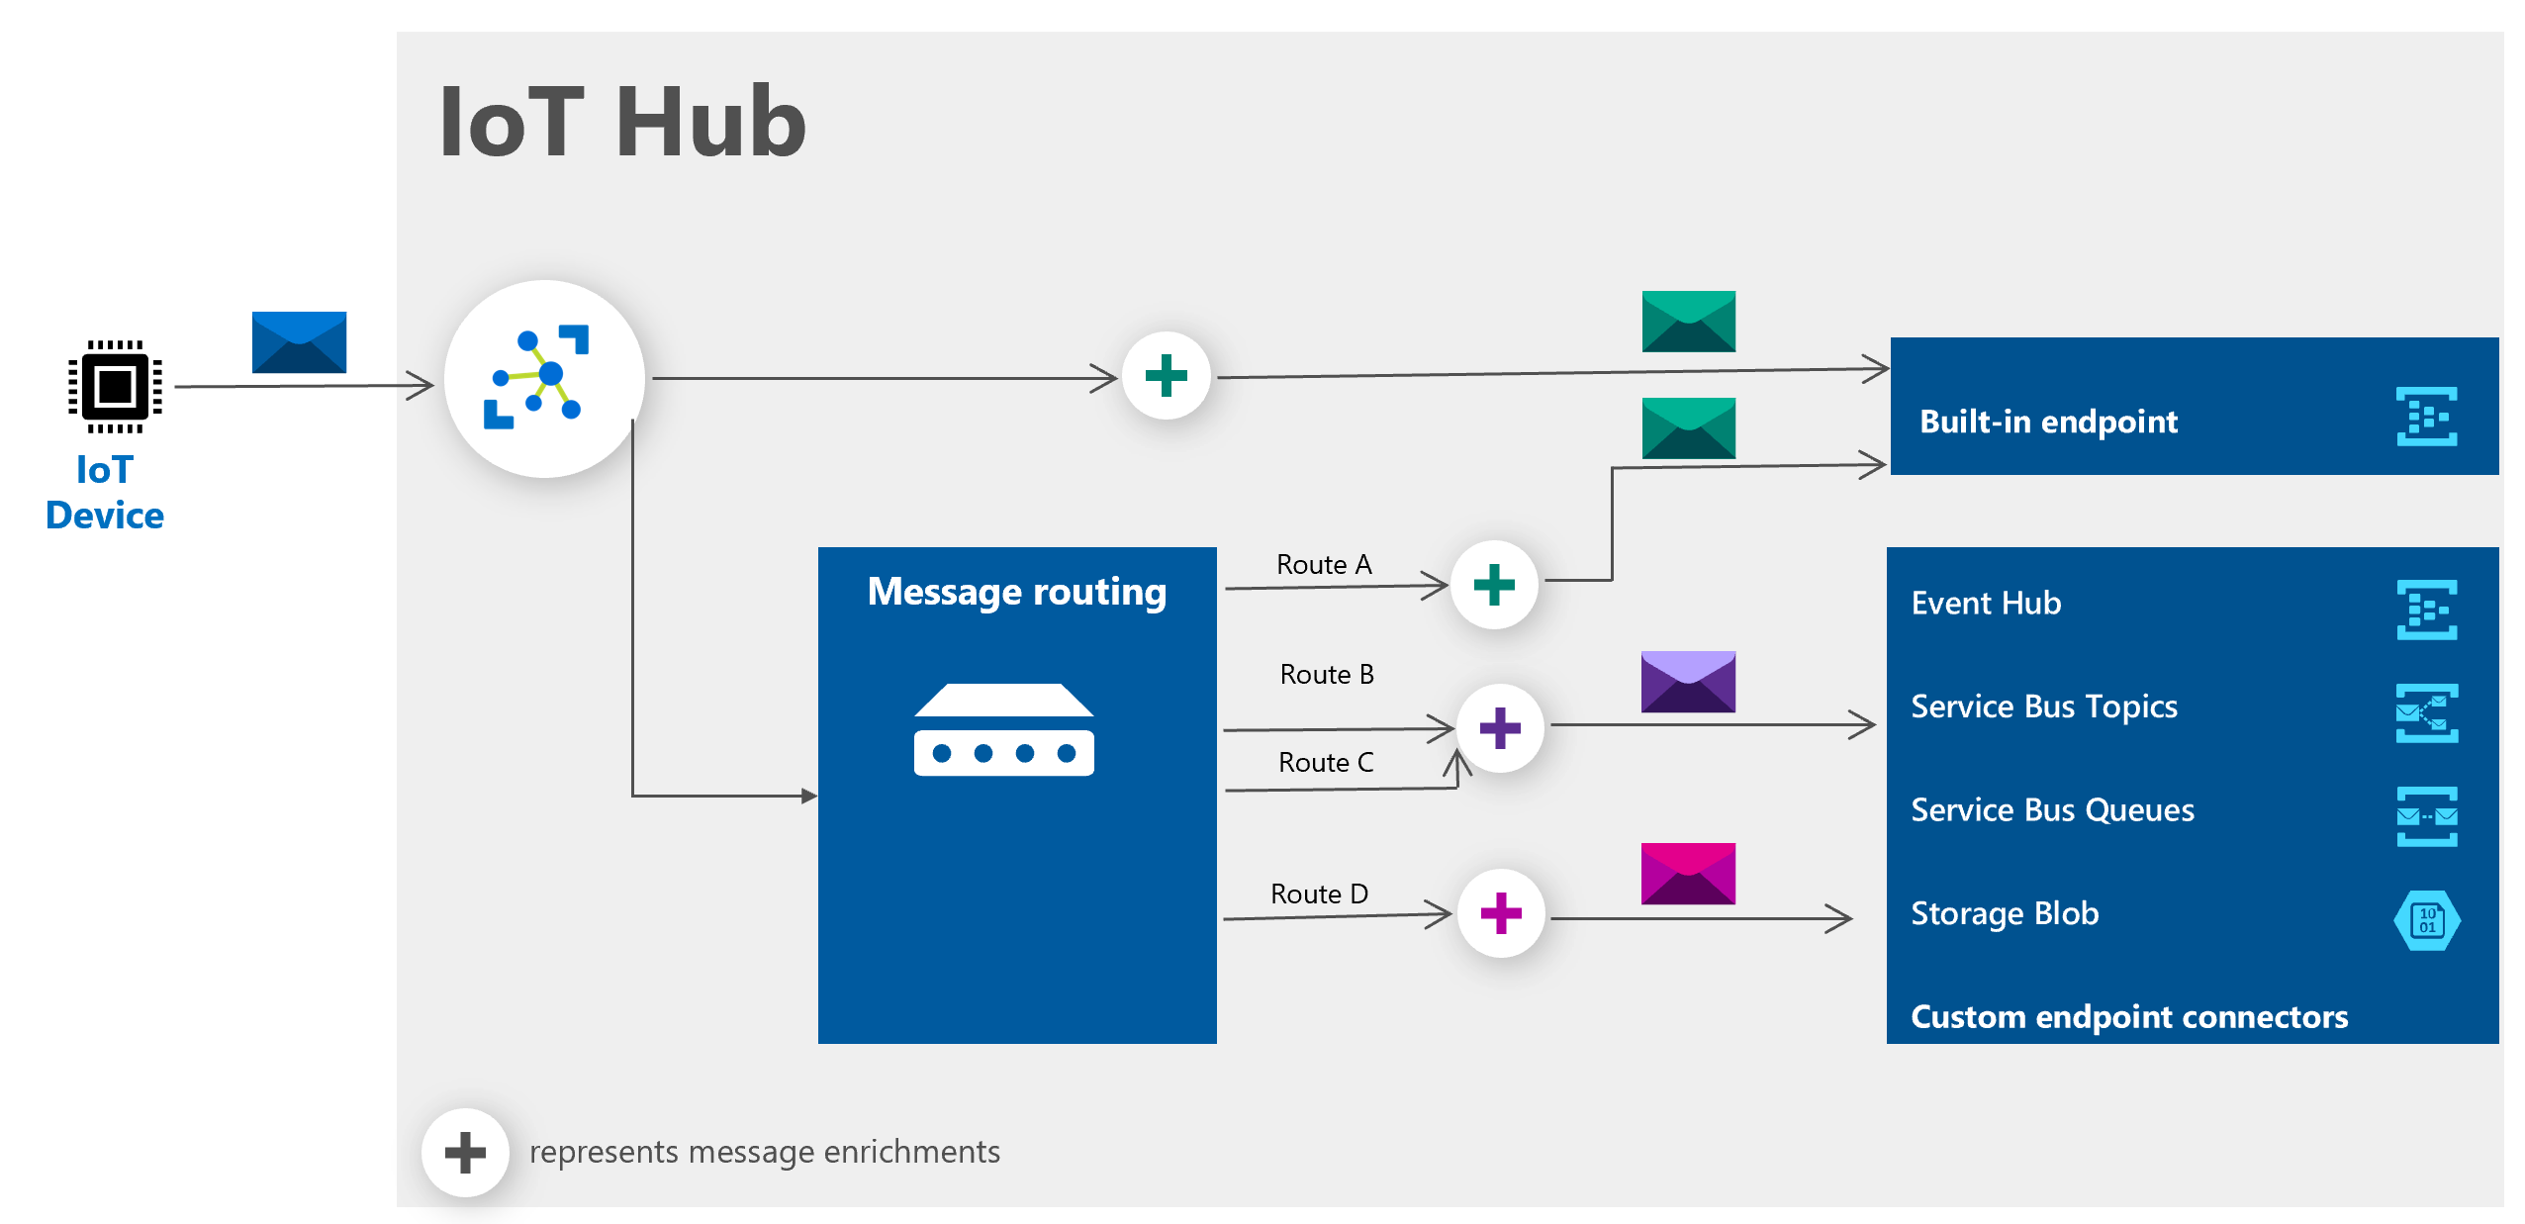
Message Enrichments for D2C Messages: Overview
Notes:
“IoT Hub Messaging has a very useful feature known as message enrichments. These allow adding extra information to the message that will be sent to a particular endpoint… the plus signs here are all meant to represent enrichment possibilities.”

Slide 18
Message Enrichments for D2C Messages: Details
Three key elements:
Enrichment name or key
A value
One or more endpoints for which the enrichment should be applied
Value possibilities
Any static string
The name of the IoT hub sending the message, $iothubname.
Information from the device twin, such as its path, tags such as $twin.tags.field, or twin properties such as $twin.properties.reported.fanspeed.
Notes:
“Let’s look at the details of enrichment a little bit…”

Slide 19
IoT Hub Quotas and Throttling
Operation Throttles
Throttling Details – tied to the number of units in the specific tier, based on number of 4 KB messages (0.5 KB for the Free tier)
Traffic shaping – IoT Hub will allow a certain amount of burst above the quota, then will queue, then finally will reject messages with a 429 error
Identity registry operations throttle – export and import are available for batch operations
Device connections throttle – 100 per second per unit for new connections (existing connections don’t count)
Other limits
Latency
Depends on network
Impacted by throttling
Notes:
“One other thing for me to mention – IoT Hub doesn’t allow an unlimited number of messages to flow. There are limits…”
This is a good chance to show https://http.cat/429, if that fits with your personality, since that’s a fun site and many students won’t know the 429 error code.
For “other limits,” point out there are limits like the total number of devices on one hub (1,000,000), etc. but you’re leaving it as an exercise for the reader for the details, as they are trivia.

Slide 20
Lesson 04: Data Storage and the Lambda Architecture

Slide 21
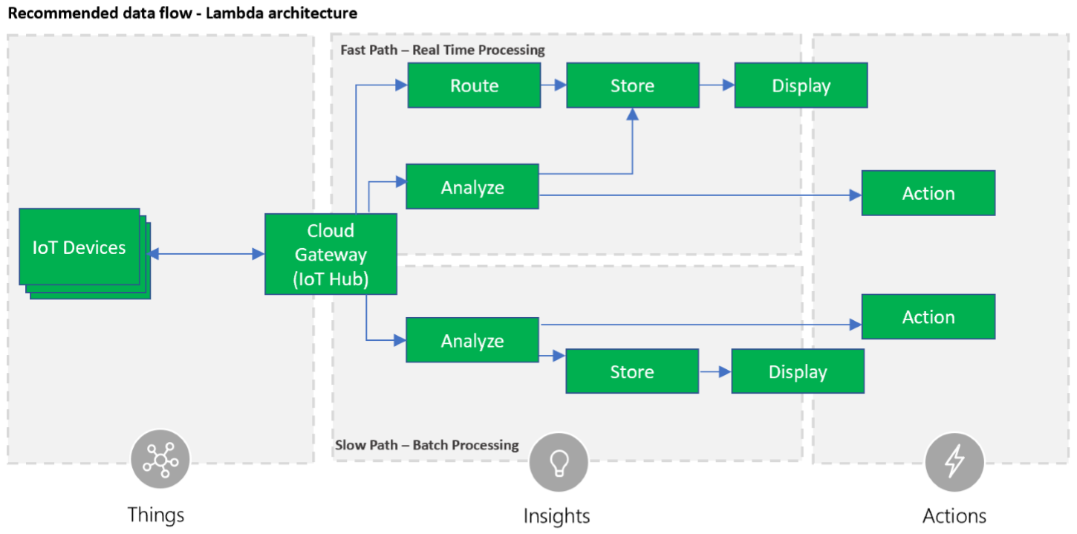
Introduction to Lambda Architecture
Notes:
A lot of the course, as previously mentioned, is designed with a “high level to low level,” “walk the student down a path” model. This is a good example of this. We started with the concept of message routing, and here we are giving a specific instance of how you would use message routing.
There is a lot of discussion in the industry around Lambda Architecture, its use, and its future. That said, it is being used today in many cases and is not going anywhere anytime soon. So we are directly addressing it here. Your students may have opinions on this or may know about it – this is a good in-room conversation prompt.
Fundamentally, Lambda Architecture assumes a fast path, or “hot” path, and a slow path, or “cold” path, where you’re reflecting that different kinds of storage and processing have different costs, and are driven by different requirements.

Slide 22
Common Storage Options for Azure IoT Solutions
Azure Storage Accounts
Azure Data Lake Gen2
Azure Cosmos DB
Azure SQL Database
Notes:
“When we talk about data storage in Azure IoT Solutions, there are four main storage options for IoT storage…”

Slide 23
Azure Storage Accounts
Storage services
Blob
Files
Queues
Tables
Types of storage accounts
General-purpose v1 and v2, BlockBlobStorage, FileStorage, BlobStorage
Securing access to storage accounts
Azure AD, Shared Key, Shared Access Signature, Anonymous
Notes:
This is not a big data, or even data, class – there are other courses (DP-200, DP-201, AI-100, etc.) that get more into those topics. Here we are doing a high-level list just to explain that these options are there, and let it be an exercise for the reader to find out more. If you’d like to get into more detail on the data targets, you may of course, but be sure to time box it to avoid going into ratholes.

Slide 24
Azure Data Lake Gen 2
Designed for big data analytics
Performance is optimized because it’s built for analysis
Management is easier because data is organized in files and directories
Security is enforceable because you can define POSIX permissions on directories or individual files
Cost effective because Data Lake Storage Gen2 is built on top of the low-cost Azure Blob storage
Key features of Data Lake Storage Gen2
Hadoop compatible access
A superset of POSIX permissions
Cost effective
Optimized ABFS driver

Slide 25
Azure Cosmos DB
Natively partitions data for 99.99% guarantees for availability, throughput, low latency, and consistency on all single-region accounts and all multi-region accounts with relaxed consistency, and 99.999% read availability on all multi-region database accounts
SSD backed storage with low-latency order-of-millisecond response
Five levels of selectable consistency
Flexible data-friendly pricing model that meters storage and throughput independently.
A reserved throughput model allows you to think in terms of number of reads/writes instead of underlying hardware.
Massive scalability on the order of trillions of requests per day

Slide 26
Azure SQL Database
Business Continuity: Azure SQL Database will handle the disruptive events that might happen in the cloud environment and keep your applications and business processes running
High Availability: 99.99% uptime
Automated Backups: automatic backups that are kept between 7 and 35 days, and uses Azure read-access geo-redundant storage (RA-GRS) to ensure that they are preserved even if the data center is unavailable. Long-term retention also available.
Geo-Replication: Auto-failover groups across regions
Scale Resources: Dynamically add more resources to your database with minimal downtime

Slide 27
Lesson 05: Azure Stream Analytics

Slide 28
What is Message Processing?
Notes:
“Wait, we already presented this slide!” we could hear you saying. We duplicate it here because we’re highlighting a different part of the diagram now – this is intended to loop this lesson back to the introductory info.

Slide 29
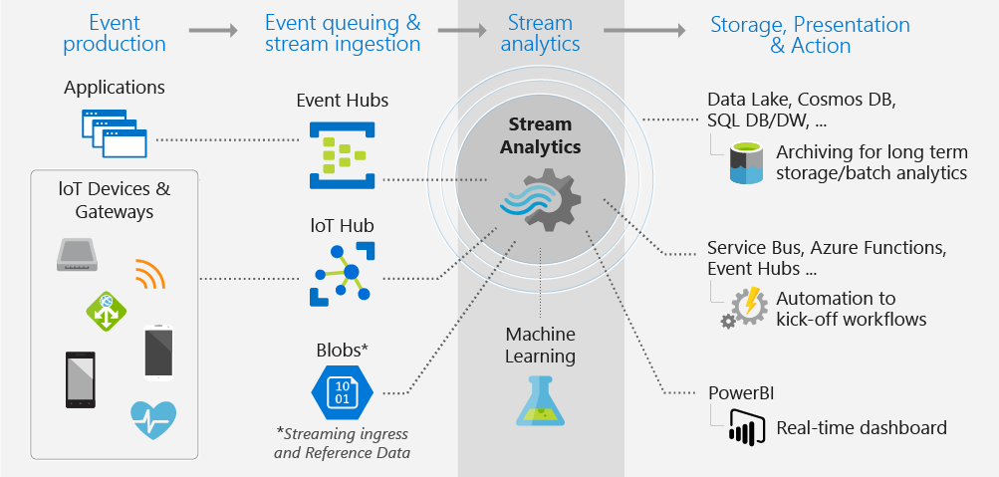
What is Azure Stream Analytics (ASA)?
Notes:
“While the previous slide was around the high-level design view, we can also look at this from the point of view of the Azure Stream Analytics, or `ASA`, service itself, as if ASA is the ‘center of the universe.’ But what is ASA?”
Azure Stream Analytics is a real-time analytics and complex event-processing engine that is designed to analyze and process high volumes of fast streaming data from multiple sources simultaneously. Patterns and relationships can be identified in information extracted from a number of input sources including devices, sensors, clickstreams, social media feeds, and applications. These patterns can be used to trigger actions and initiate workflows such creating alerts, feeding information to a reporting tool, or storing transformed data for later use. Also, Stream Analytics is available on Azure IoT Edge runtime, and supports the same exact language or syntax as cloud.
The following scenarios are examples of when you can use Azure Stream Analytics:
Analyze real-time telemetry streams from IoT devices
Web logs/clickstream analytics
Geospatial analytics for fleet management and driverless vehicles
Remote monitoring and predictive maintenance of high value assets
Real-time analytics on Point of Sale data for inventory control and anomaly detection
https://docs.microsoft.com/en-us/azure/stream-analytics/stream-analytics-introduction

Slide 30
Azure Stream Analytics Data Flow
An Azure Stream Analytics job consists of an input, query, and an output
Input – ASA can ingest data from Azure Event Hubs, Azure IoT Hub, or Azure Blob Storage
Query – ASA uses a SQL-like query language that includes support for filtering, sorting, aggregating, joining, and user-defined functions
Output – ASA can output to many targets

Slide 31
ASA and Other Stream Processing Technologies
When to use Azure Stream Analytics
Recommended tool for analytics on Azure
Dashboards for data visualization
Real-time alerts from temporal and spatial patterns or anomalies
Basic Extract, Transform, and Load (ETL) work
When to use other technologies
Apache Kafka connectivity (Azure Event Hubs are a good choice here)
In-line query handling in a language besides C# or JavaScript (e. g. Java; Spark Structured Streaming or specialized Azure Event Hubs implementation are good choices here)
Multi-cloud support (Azure Stream Analytics is Azure-specific; Spark Structured Streaming, Storm, etc. will work here)
Notes:
“Before we get into details on ASA, I should acknowledge that there are other products, both inside Azure and outside of Azure, that can support a similar need…”
There’s more scenarios and justification for using ASA in the SkillPipe which you can just reference, or bring in more detail if time permits and you feel comfortable.

Slide 32
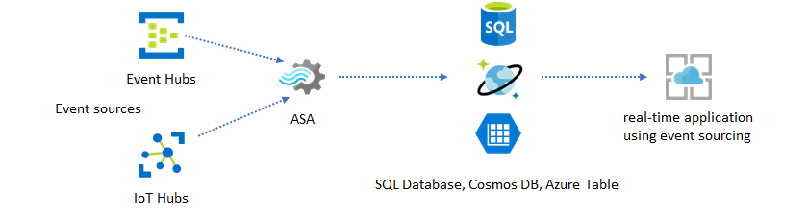
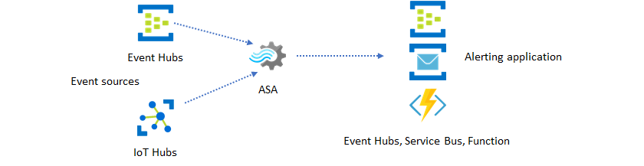
Some Common ASA Patterns and Tools
Real-time insights through data stores
Real-time insights with event messaging
Notes:
“Now that we’ve explained when to use ASA and when you might not want to use ASA, let’s deep dive on ASA a bit more…”

Slide 33
ASA Input Types
Data stream input – an unbounded sequence of events over time
Reference data input – static (or slowly changing) data used for lookups and correlation
Notes:
“ASA fundamentally is all about sending data from inputs to outputs in a real-time fashion. But what kinds of inputs are supported? It turns out ASA offers two high-level categories of inputs…”
The next two slides give some more detail.

Slide 34
ASA Streaming Data Input
Stream data from Event Hubs
SELECT
EventProcessedUtcTime,
EventEnqueuedUtcTime,
PartitionId
FROM Input
Stream data from IoT Hub
SELECT *
FROM Input
HAVING Temperature > 27
Stream data from Blob storage
SELECT
BlobName,
EventProcessedUtcTime,
BlobLastModifiedUtcTime
FROM Input
Notes:
Lab 07 covers ASA configuration.

Slide 35
ASA Reference Data Input
Azure Blob storage
Can be static or scheduled
Static reference data – immutable, with no changes over time
Generate reference data on a schedule – configured to reference a date and time in the blob path (can be from Azure Data Factory!)
Azure SQL Database
SQL Query used as a source
Stored in memory and in a storage account (configured as part of setup)
Refreshed on a regular (configurable) basis
Size limitation
Based on number of units configured for the IoT Hub – approximately 50 MB per unit

Slide 36
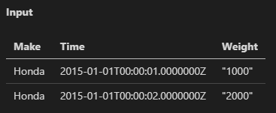
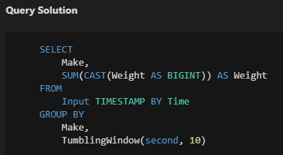
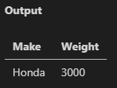
ASA Query Sample: Convert Data Types Pattern
Notes:
ASA Queries are such a huge topic that we simply can’t present it all in any kind of intelligent way, so we’re not trying. We have a couple of straightforward samples here, and let the reader look it up for more detail.

Slide 37
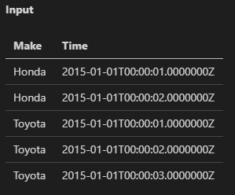
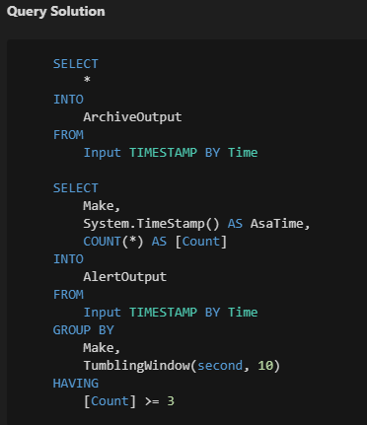
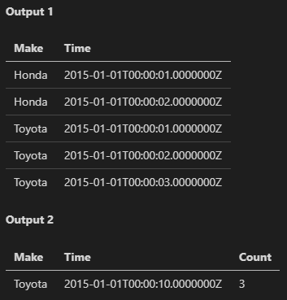
ASA Query Sample: Multiple Outputs

Slide 38
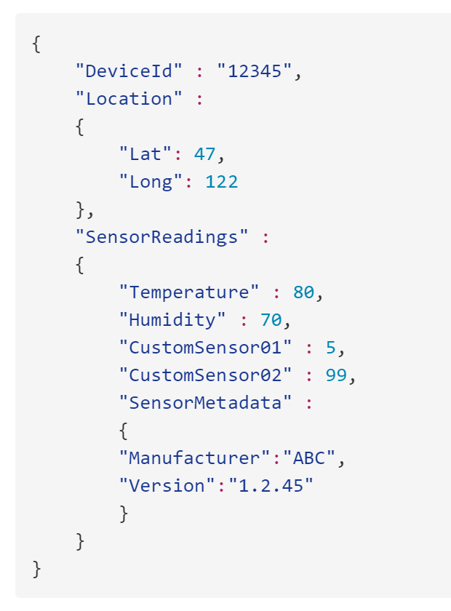
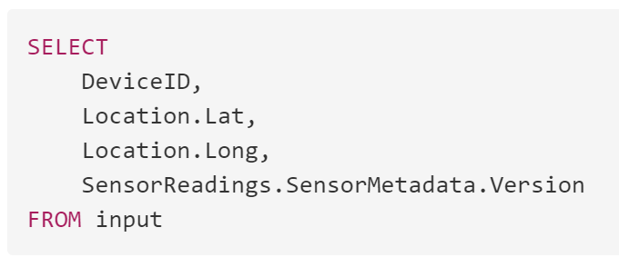
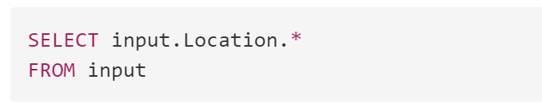
ASA Queries - Parse Complex Data Types
Record data type example:
Query examples:
Notes:
Record data types: Record data types are used to represent JSON and Avro arrays when corresponding formats are used in the input data streams.
The SkillPipe also talks about array handling and using one field as the name for another field in the record.

Slide 39
ASA Queries: Time Handling Terms
Background time concepts
Event time – the time the original event happened, such as a car arrives at a toll booth
Processing time – when the event is observed, such as when the computer system sees the sensor data indicating the car’s arrival
Watermark – a time marker indicating up to what point events have been processed
ASA lets you choose what the applicable time for an event is
Arrival time – when the event reached the input event source, after the processing time; best for when the exact time of arrival isn’t important
Application time (or event time) – when the event was originally generated
Notes:
“When you’re working with ASA queries, one important topic is time handling. Time handling is actually a very complicated topic in streaming data scenarios, however we can address it here at an introductory level…”

Slide 40
ASA Queries: How Time Progresses in ASA
Stream processing requires relevant watermarks for data processing to be meaningful
ASA generates watermarks with a specific algorithm when you’ve selected event time (application time)
When there’s an incoming event, the watermark is the largest selected time value seen so far, minus any configured out-of-order tolerance
When there’s no incoming event, the watermark is an estimated time based on the last time seen so far, plus time progression in the ASA environment, minus any out-of-order tolerance
Watermarks in most systems and by default in ASA are partition-level (effectively global), but can be per-device through substreams

Slide 41
ASA Queries: Late and early arrivals
Late arriving events – arrive with a time “sooner” than the watermark, meaning outside of configured tolerance
Can be dropped
Can be forced to the watermark time
Early arriving events – arrive with an input arrival time “sooner” than the output start time as specified in the query
Corrects the inherent discrepancy in the concept of output time (as specified in the query) and the concept of input arrival time
Fixed tolerance of five (5) minutes, meaning the system looks at arrival times five minutes back from the requested start time to ensure no events are “lost” in that window
Allows repeatable output no matter where you start the query from
Notes:
This is a very complicated topic, and it’s not expected that the students will completely get this here. There’s more details on the implications of these two tolerances in the SkillPipe.
The SkillPipe also gives specific visualizations of this which we’re choosing not to include here, as walking through them is just too complicated for a classroom situation.

Slide 42
ASA Queries: Output Windows
Temporal windows are very common
ASA has native windowing functions
Windows are always collected at the end of the window, to a single event, based on the aggregate function used
There are four window types, covered on the next slides…
Notes:
In time-streaming scenarios, performing operations on the data contained in temporal windows is a common pattern. Stream Analytics has native support for windowing functions, enabling developers to author complex stream processing jobs with minimal effort.
There are four kinds of temporal windows to choose from: Tumbling, Hopping, Sliding, and Session windows. You use the window functions in the GROUP BY clause of the query syntax in your Stream Analytics jobs. You can also aggregate events over multiple windows using the Windows() function.
All the windowing operations output results at the end of the window. The output of the window will be single event based on the aggregate function used. The output event will have the time stamp of the end of the window and all window functions are defined with a fixed length.
https://docs.microsoft.com/en-us/azure/stream-analytics/stream-analytics-window-functions

Slide 43
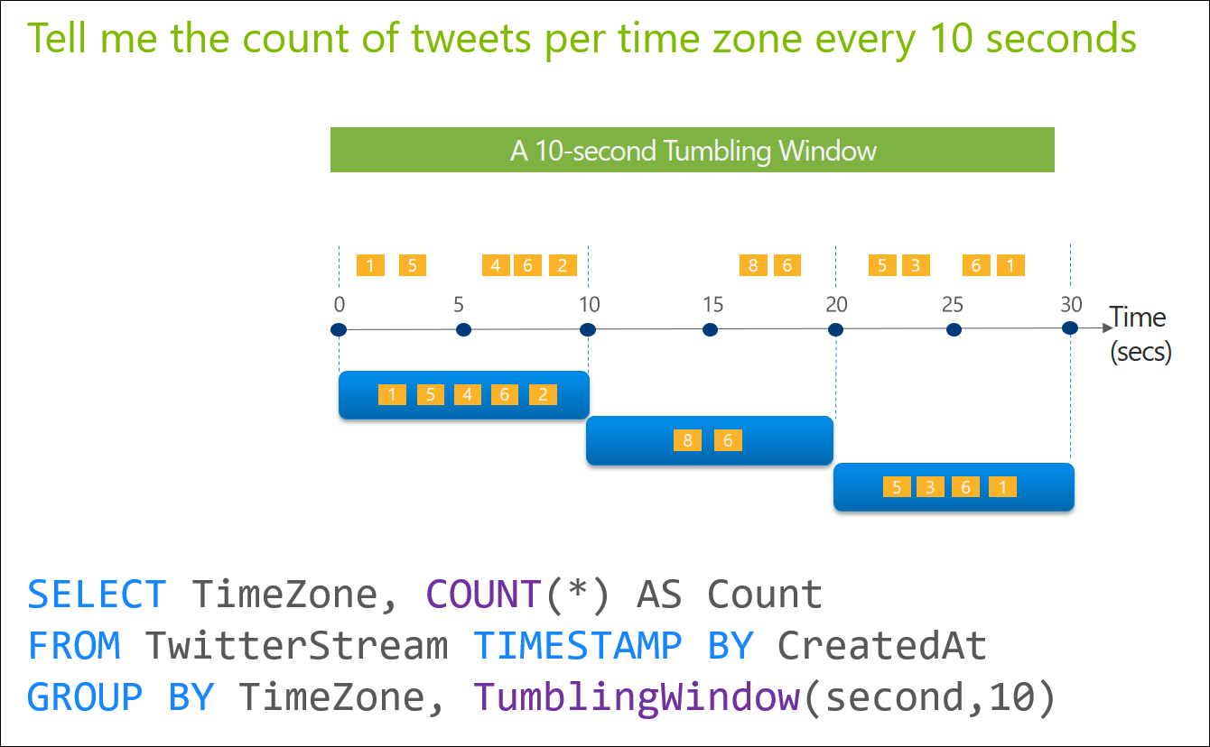
ASA Queries: Tumbling Window
Notes:
Tumbling window functions are used to segment a data stream into distinct time segments and perform a function against them, such as the example below. The key differentiators of a Tumbling window are that they repeat, do not overlap, and an event cannot belong to more than one tumbling window.

Slide 44
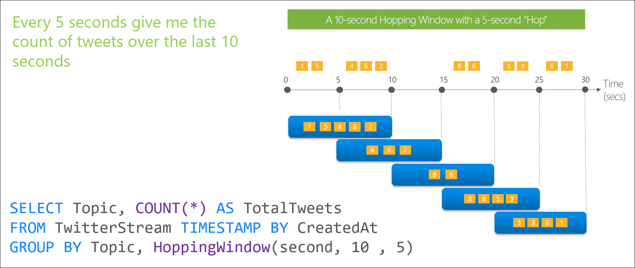
ASA Queries: Hopping Window
Notes:
Hopping window functions hop forward in time by a fixed period. It may be easy to think of them as Tumbling windows that can overlap, so events can belong to more than one Hopping window result set. To make a Hopping window the same as a Tumbling window, specify the hop size to be the same as the window size.

Slide 45
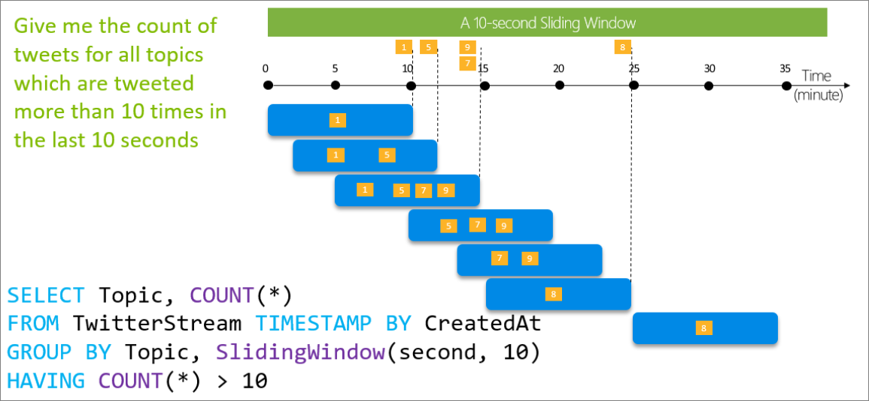
ASA Queries: Sliding Window
Notes:
Sliding window functions, unlike Tumbling or Hopping windows, produce an output only when an event occurs. Every window will have at least one event and the window continuously moves forward by an € (epsilon). Like hopping windows, events can belong to more than one sliding window.

Slide 46
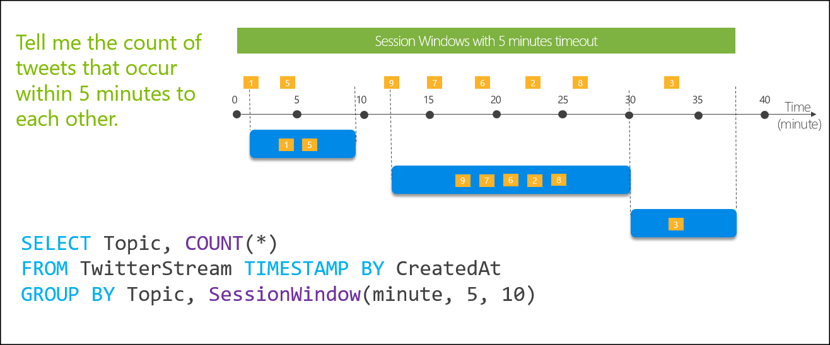
ASA Queries: Session Window
Notes:
Session window functions group events that arrive at similar times, filtering out periods of time where there is no data. It has three main parameters: timeout, maximum duration, and partitioning key (optional).
A session window begins when the first event occurs. If another event occurs within the specified timeout from the last ingested event, then the window extends to include the new event. Otherwise if no events occur within the timeout, then the window is closed at the timeout.
If events keep occurring within the specified timeout, the session window will keep extending until maximum duration is reached. The maximum duration checking intervals are set to be the same size as the specified max duration. For example, if the max duration is 10, then the checks on if the window exceed maximum duration will happen at t = 0, 10, 20, 30, etc.
When a partition key is provided, the events are grouped together by the key and session window is applied to each group independently. This partitioning is useful for cases where you need different session windows for different users or devices.

Slide 47
ASA Output Options
Azure Data Lake Storage Gen 1 – original Azure “big data” processing storage target
SQL Database – (as previously discussed)
Blob Storage (with Azure Data Lake Storage Gen 2) – (as previously discussed)
Event Hubs – (as previously discussed with more detail coming)
Power BI – desktop visualization, as will be seen in the lab
Table storage – (as previously discussed)
Service Bus queues or topics – one-to-one or one-to-many messaging
Azure Cosmos DB – (as previously discussed)
Notes:
“That covers the query capabilities of ASA. Once data has gone through the queries, it gets sent to the job output destination…”
… “details on specific limitations around data size limits and the like for each output type are in the SkillPipe.”

Slide 48
Azure Functions: Features
Choice of language
Pay-per-use pricing option
Easy integration with other Azure services and with Oauth providers
Flexible development – portal, CI/CD, etc.
Open source, cross-platform runtime
Notes:
“One last output option for ASA is Azure Functions…”

Slide 49
Lesson 06: Module 4 Labs

Slide 50
Module 4 Labs
Lab 7: Device Message Routing

Slide 51
Lesson 07: Module 4 review questions

Slide 52
Module Review: Question 4.1
You are developing an IoT solution for your company. You have a device connected to your IoT hub and you’ve verified that you’re receiving telemetry data. You need the sensor data routed to an Azure Service Bus queue endpoint as well as the built-in endpoint. You ensure that the fallback route is enabled on the Message routing pane of your IoT Hub blade.
Which of the following are correct? (choose all correct answers)
You need to create a route to the Azure Service Bus queue endpoint.
You don’t need to create a route to the built-in end point because it will receive all data by default regardless of any other routes created.
You need to create a route to the built-in end point, otherwise any data that is routed to the Azure Service Bus queue endpoint will not reach the built-in endpoint.
You cannot create a custom route to the built-in endpoint.
Notes:
Correct Answer: A, C
Explanation: In the student workbook/skillpipe content, topic Introduction to Message Routing includes the following:
IoT Hub Built-in Endpoint
By default, messages are routed to the built-in service-facing endpoint (messages/events) that is compatible with Event Hubs. This endpoint is currently only exposed using the AMQP protocol on port 5671.
If you're using message routing and the fallback route is enabled, all messages that don't match a query on any route go to the built-in endpoint. If you disable this fallback route, messages that don't match any query are dropped.
In the student workbook/skillpipe content, topic Message Routing to Multiple Endpoints includes the following:
Fallback route
The fallback route sends all the messages that don't satisfy query conditions on any of the existing routes to the built-in-Event Hubs (messages/events), that is compatible with Event Hubs. If message routing is turned on, you can enable the fallback route capability. Once a route is created, data stops flowing to the built-in-endpoint, unless a route is created to that endpoint. If there are no routes to the built-in-endpoint and a fallback route is enabled, only messages that don't match any query conditions on routes will be sent to the built-in-endpoint. Also, if all existing routes are deleted, fallback route must be enabled to receive all data at the built-in-endpoint.
You can enable/disable the fallback route in the Azure portal->Message Routing blade. You can also use Azure Resource Manager for FallbackRouteProperties to use a custom endpoint for fallback route.

Slide 53
Module Review: Question 4.2
You are developing an IoT solution for your company. You have a device connected to your IoT hub and you have verified that you are receiving telemetry data. You need to create routing queries that take full advantage of the capabilities.
Which of the following can you query on within your routing query? (choose all correct answers)
message properties and message body (if the message body is not JSON).
message properties and message body (if the message body is JSON).
device twin tags.
device twin properties.
Notes:
Correct Answer: B, C, D
Explanation: In the student workbook/skillpipe content, topic Message Routing Query Syntax includes the following:
Message Routing Query Syntax
Message routing enables users to route different data types namely, device telemetry messages, device lifecycle events, and device twin change events to various endpoints. You can also apply rich queries to this data before routing it to receive the data that matters to you.
Message routing allows you to query on the message properties and message body as well as device twin tags and device twin properties. If the message body is not JSON, message routing can still route the message, but queries cannot be applied to the message body. Queries are described as Boolean expressions where a Boolean true makes the query succeed which routes all the incoming data, and Boolean false fails the query and no data is routed. If the expression evaluates to null or undefined, it is treated as false and an error will be generated in diagnostic logs in case of a failure. The query syntax must be correct for the route to be saved and evaluated.

Slide 54
Module Review: Question 4.3
You are developing an IoT solution for your company. You have a device connected to your IoT hub and you verify that you are receiving telemetry. You will need to store time series data to a storage resource that you will be accessing frequently (hot storage path). High availability and performance are critical, but you need the solution to be cost effective as well. You must be able to query the stored data as unstructured JSON.
Which storage option should you select? (choose one best answer)
Azure SQL Database
Azure Blob Storage
Azure Cosmos DB
Azure Data Lake Storage
Notes:
Correct Answer: C
Explanation: In the student workbook/skillpipe content, topic Azure Cosmos DB includes the following:
Today’s applications are required to be highly responsive and always online. To achieve low latency and high availability, instances of these applications need to be deployed in datacenters that are close to their users. Applications need to respond in real time to large changes in usage at peak hours, store ever increasing volumes of data, and make this data available to users in milliseconds.
Key Benefits
- Azure Cosmos DB natively partitions your data for high availability and scalability. Azure Cosmos DB offers 99.99% guarantees for availability, throughput, low latency, and consistency on all single-region accounts and all multi-region accounts with relaxed consistency, and 99.999% read availability on all multi-region database accounts.
- Azure Cosmos DB has SSD backed storage with low-latency order-of-millisecond response times.
- Azure Cosmos DB's support for consistency levels like eventual, consistent prefix, session, and bounded-staleness allows for full flexibility and low cost-to-performance ratio. No database service offers as much flexibility as Azure Cosmos DB in levels consistency.
- Azure Cosmos DB has a flexible data-friendly pricing model that meters storage and throughput independently.
- Azure Cosmos DB's reserved throughput model allows you to think in terms of number of reads/writes instead of CPU/memory/IOPs of the underlying hardware.
- Azure Cosmos DB's design lets you scale to massive request volumes in the order of trillions of requests per day.
Note: Azure Stream Analytics can target Azure Cosmos DB for JSON output, enabling data archiving and low-latency queries on unstructured JSON data.
In the student workbook/skillpipe content, topic ASA Outputs includes the following:
Azure Cosmos DB
Azure Cosmos DB is a globally distributed database service that offers limitless elastic scale around the globe, rich query, and automatic indexing over schema-agnostic data models.
Azure Stream Analytics can target Azure Cosmos DB for JSON output, enabling data archiving and low-latency queries on unstructured JSON data.

Slide 55
Module Review: Question 4.4
You are developing an IoT solution for your company. You have a large number of devices connected to IoT Hub. Each device is sending telemetry on a regular basis. You also have archived data available on both hot and cold paths. You have selected Azure Stream Analytics to help you analyze the data. You begin setting up you first Azure Stream Analytics job.
What are the components of an Azure Stream Analytics job? (choose one best answer)
Hub, Action, and Storage
From, With, and Into
Input, Query, and Output
Input, Action, and Output
Notes:
Correct Answer: C
Explanation: In the student workbook/skillpipe content, topic What is Azure Stream Analytics includes the following:
How does Stream Analytics work?
An Azure Stream Analytics job consists of an input, query, and an output. Stream Analytics ingests data from Azure Event Hubs, Azure IoT Hub, or Azure Blob Storage. The query, which is based on SQL query language, can be used to easily filter, sort, aggregate, and join streaming data over a period of time. You can also extend this SQL language with JavaScript and C# user defined functions (UDFs). You can easily adjust the event ordering options and duration of time windows when preforming aggregation operations through simple language constructs and/or configurations.
Each job has an output for the transformed data, and you can control what happens in response to the information you've analyzed. For example, you can:
- Send data to services such as Azure Functions, Service Bus Topics or Queues to trigger communications or custom workflows downstream.
- Send data to a Power BI dashboard for real-time dashboarding.
Store data in other Azure storage services to train a machine learning model based on historical data or perform batch analytics.

Slide 56
Module Review: Question 4.5
You are developing an IoT solution for your company. You have a large number of devices connected to IoT Hub. Each device is sending telemetry on a regular basis. You also have archived data available on both hot and cold paths. You have selected Azure Stream Analytics to help you analyze the data. You need to set up an ASA Windowing function that will outputs results every 10 seconds. The results should be based on data from previous 30 seconds.
Which one of the Windowing function types should you use to achieve the desired results? (choose one best answer)
Tumbling window
Hopping window
Sliding window
Session window
Notes:
Correct Answer: B
Explanation: In the student workbook/skillpipe content, topic Introduction to ASA Windowing Functions includes the following:
Tumbling window
Tumbling window functions are used to segment a data stream into distinct time segments and perform a function against them, such as the example below. The key differentiators of a Tumbling window are that they repeat, do not overlap, and an event cannot belong to more than one tumbling window.
Hopping window
Hopping window functions hop forward in time by a fixed period. It may be easy to think of them as Tumbling windows that can overlap, so events can belong to more than one Hopping window result set. To make a Hopping window the same as a Tumbling window, specify the hop size to be the same as the window size.
Sliding window
Sliding window functions, unlike Tumbling or Hopping windows, produce an output only when an event occurs. Every window will have at least one event and the window continuously moves forward by an € (epsilon). Like hopping windows, events can belong to more than one sliding window.
Session window
Session window functions group events that arrive at similar times, filtering out periods of time where there is no data. It has three main parameters: timeout, maximum duration, and partitioning key (optional).

